Slide 1

DEPARTMENT OF COMPUTER SCIENCE AND ENGINEERING (AI&ML)
Pedestrian Detection using YOLOv8 with OpenVINO Optimization
PRESENTED BY
P. SAI SRIKAR – [ROLL.NO – 22671A6631]
P. SAIDEEP – [ROLL.NO – 22671A6651]
B. SHRUTI – [ROLL.NO – 22671A6653]
GUIDANCE BY : MR. MD. MAHEBUB ALI,
ASSISTANT PROFESSOR, AI&ML

Slide 2
Abstract:
Pedestrian detection is a critical component in autonomous driving, surveillance systems, and smart traffic management, where real-time accuracy and computational efficiency are paramount. This project presents a pedestrian detection system developed using the YOLOv8s deep learning model trained on the KITTI Vision Benchmark dataset, comprising 1,779 annotated pedestrian images captured from a front-facing dashcam perspective. The trained model achieved a mean Average Precision (mAP50) of 0.842, with a precision of 0.887 and recall of 0.733, demonstrating strong detection performance on real-world driving scenarios. To address the challenge of deploying deep learning models on resource-constrained hardware without dedicated GPU support, Intel's OpenVINO toolkit was employed to optimize the trained model through INT8 post-training quantization, reducing the model size from 42.8 MB to 11 MB and achieving a 2.24× inference speedup over standard PyTorch, enabling real-time detection at 30 frames per second on a standard Intel CPU. The optimized model was further integrated into an interactive web application built using Flask, HTML, CSS, and JavaScript, providing features including image detection, video processing, and a dataset browser for live demonstrations. This project demonstrates that high-accuracy pedestrian detection can be achieved and deployed efficiently on commodity hardware through model optimization, making it viable for edge computing and real-world autonomous systems without the need for expensive GPU infrastructure.

Slide 3
DATASET OVERVIEW
Attribute | Description
Dataset Name | KITTI Vision Benchmark Suite
Number of Classes | 8 object classes
Data Type | RGB images with text based annotation files
Dataset Split | 1,779 pedestrian images filtered from 7,481
Dataset Source : https://www.kaggle.com/datasets/klemenko/kitti-dataset

Slide 4
Existing Systems
Traditional Methods (HOG + SVM, Haar Cascades)
Used handcrafted features.
Limited accuracy in complex environments.
Sensitive to lighting and occlusion.
Classical Machine Learning Approaches
Improved classification using engineered features.
Poor generalization in dynamic scenes.
Not reliable for high-resolution real-time video.
Deep Learning-Based Systems (R-CNN, SSD, YOLO)
Higher accuracy using CNNs.
Suitable for complex scenes.
Require GPU for real-time performance.
Focus mainly on accuracy, not deployment efficiency.

Slide 5
Limitations of existing systems
Depend heavily on GPU hardware for real-time performance
High computational and power requirements
Limited CPU-based optimization
Poor performance in occlusion and complex backgrounds
Sensitive to lighting and environmental variations
Many models focus on accuracy over deployment efficiency
Not fully suitable for edge or resource-constrained devices

Slide 6
Proposed System
Uses YOLOv8 for accurate pedestrian detection
Trained on KITTI dataset for real-world road scenarios
Evaluated using Precision, Recall, mAP, and FPS
Model exported to ONNX format
Optimized using OpenVINO for CPU-based inference
Achieves real-time performance without GPU dependency
Structured pipeline from training to deployment
Suitable for edge AI and resource-constrained environments

Slide 7
technologies USED
Python 3.10 — Core language for model inference and system integration
Flask — Backend API endpoints and web server
NumPy — Array operations and tensor preprocessing
PyTorch — Model training with CUDA on Tesla T4 GPU
YOLOv8s (Ultralytics) — Pedestrian detection model, 11.2M parameters
Google Colab — Cloud GPU training environment
Intel OpenVINO — INT8 quantization, 2.24x CPU speedup
NNCF — Calibration during INT8 quantization
OpenCV — Frame extraction, bounding box drawing, preprocessing
HTML5 / CSS3 — Dark themed responsive web interface
JavaScript — Image/video upload and dynamic result rendering
Anaconda — Conda environment management
KITTI Dataset — 1,779 pedestrian images for training and validation

Slide 8
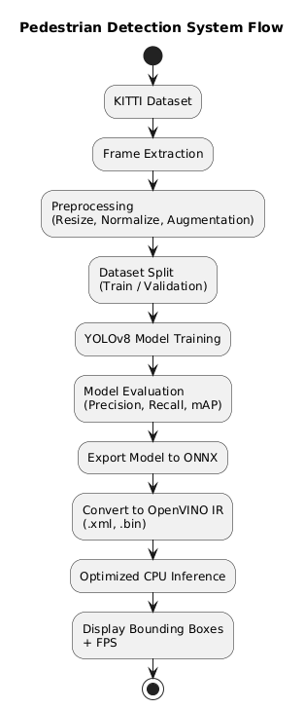
PROPOSED SYSTEM WORK FLOW DIAGRAM

Slide 9
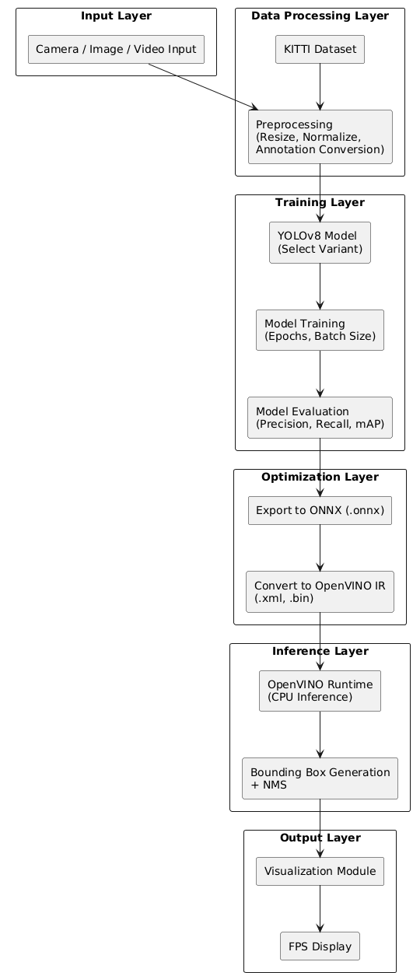
SYSTEM ARCHITECTURE
The system architecture follows a structured pipeline starting from data input to optimized real-time detection output. Initially, the KITTI dataset is loaded and preprocessed through resizing, normalization, and annotation conversion into YOLO format. The processed data is then used to train the YOLOv8 model, where hyperparameters such as epochs and batch size are configured. After training, the model is evaluated using performance metrics like Precision, Recall, and mAP to ensure detection accuracy.
Once satisfactory performance is achieved, the trained model is exported to ONNX format and converted into OpenVINO’s Intermediate Representation (IR) format. OpenVINO optimizes the model for efficient CPU-based inference. During deployment, the optimized model processes image, video, or live camera input, generates bounding boxes with confidence scores, applies Non-Maximum Suppression (NMS), and displays the final detection results along with FPS. This architecture ensures both high detection accuracy and efficient real-time CPU performance.

Slide 10
Optimization Module
.
SYSTEM MODULES
Dataset Preparation Module Preprocess KITTI dataset, resize images, convert annotations to YOLO format, and split data.
YOLOv8 Training Module Train and fine-tune the YOLOv8 model using selected hyperparameters.
Model Evaluation Module Evaluate performance using Precision, Recall, mAP, and FPS.
Model Conversion Module Export trained model to ONNX format for interoperability.
OpenVINO Optimization Module Convert ONNX model to IR format and optimize for CPU-based inference.
Inference Module Perform real-time pedestrian detection on image, video, or camera input.
Visualization Module Display bounding boxes, confidence scores, and FPS.

Slide 11
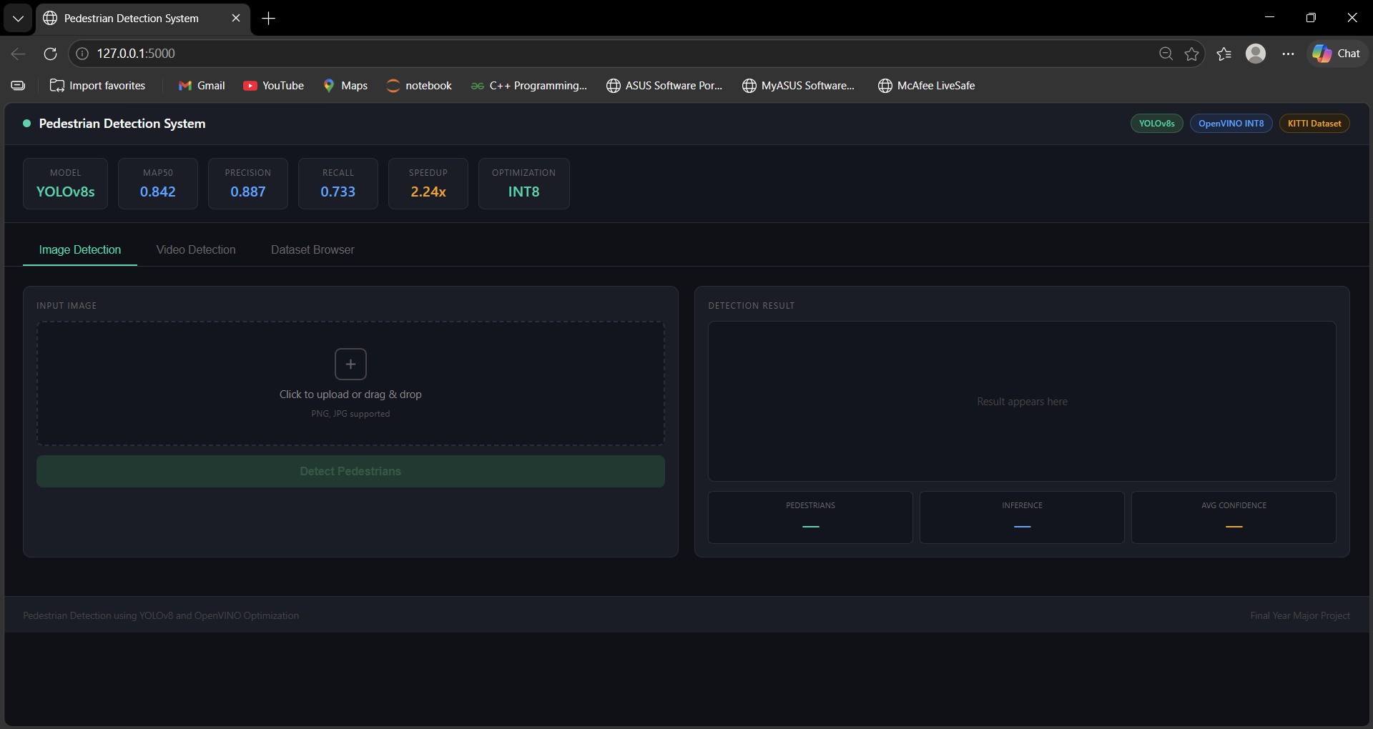
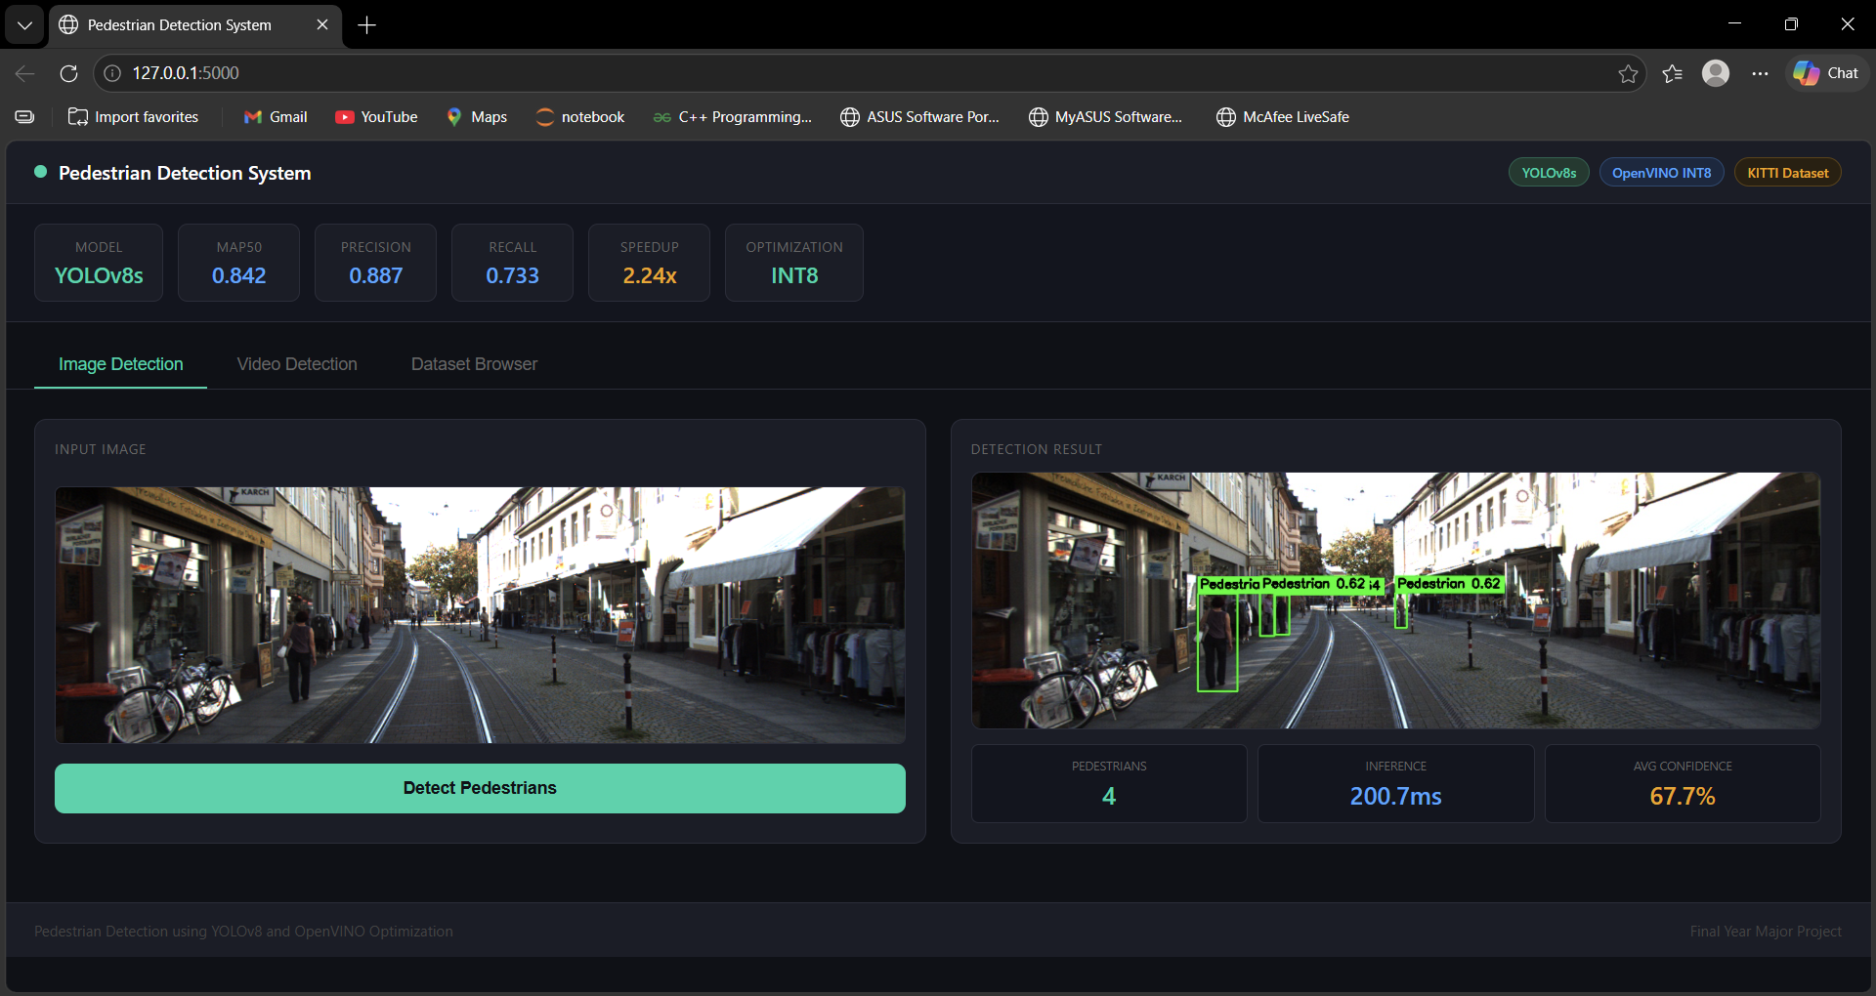
RESULTS

Slide 13
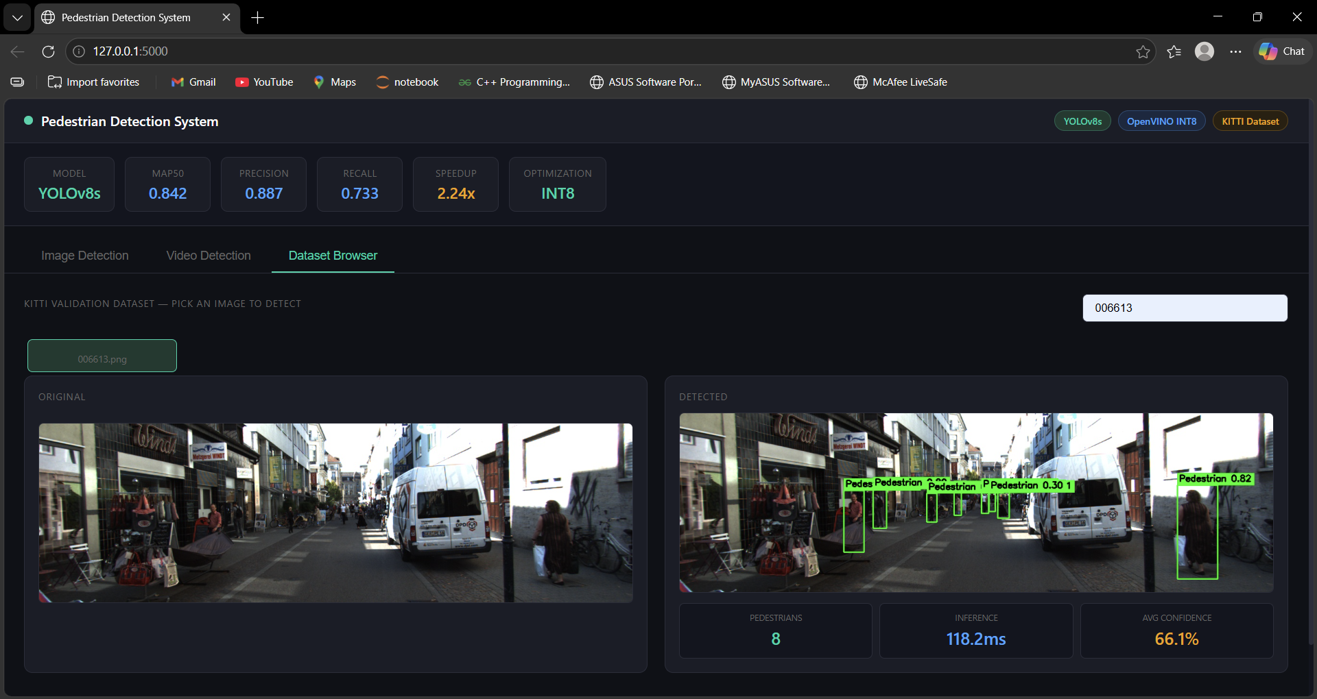

Slide 14
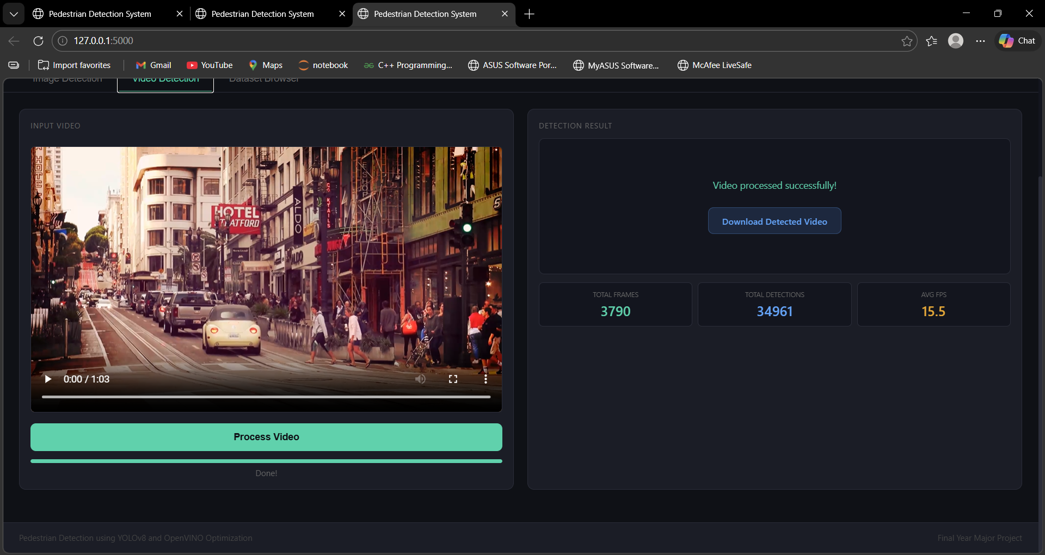
RESULTS

Slide 15
conclusion
This project demonstrates the successful development of an efficient and reliable pedestrian detection system using advanced deep learning and optimization techniques. By integrating the YOLOv8 model with the OpenVINO toolkit, the system achieves accurate real-time pedestrian detection while maintaining high performance and reduced computational complexity. The use of the KITTI Vision Benchmark dataset enabled effective training and evaluation under diverse real-world conditions. The project highlights the importance of computer vision in intelligent surveillance, traffic monitoring, and smart city applications. Overall, the proposed system provides a scalable and practical solution for real-time object detection and can be further enhanced in the future with improved datasets, advanced tracking algorithms, and deployment on edge devices for wider real-world adoption.

Slide 16
Future scope
The future scope of this project includes improving detection accuracy and speed by using more advanced deep learning architectures and larger diversified datasets. The system can be extended to support multi-object detection, pedestrian tracking, and behavior analysis for enhanced real-time surveillance applications. Integration with edge devices, IoT systems, and cloud platforms can enable efficient deployment in smart cities, autonomous vehicles, and traffic management systems. Further enhancements such as low-light detection, weather-resistant performance, and real-time alert mechanisms can increase the reliability and usability of the system in complex real-world environments.

Slide 17
References
Redmon, Joseph, et al. “You Only Look Once: Unified, Real-Time Object Detection.” Proceedings of the IEEE Conference on Computer Vision and Pattern Recognition (CVPR), 2016, pp. 779–788.
Ultralytics. YOLOv8 Documentation. Ultralytics Inc., 2023, https://docs.ultralytics.com.
Geiger, Andreas, Philip Lenz, and Raquel Urtasun. “Are We Ready for Autonomous Driving? The KITTI Vision Benchmark Suite.” Proceedings of the IEEE Conference on Computer Vision and Pattern Recognition (CVPR), 2012, pp. 3354–3361.
Dalal, Navneet, and Bill Triggs. “Histograms of Oriented Gradients for Human Detection.” Proceedings of the IEEE Conference on Computer Vision and Pattern Recognition (CVPR), 2005, pp. 886–893.
Girshick, Ross, et al. “Rich Feature Hierarchies for Accurate Object Detection and Semantic Segmentation.” Proceedings of the IEEE Conference on Computer Vision and Pattern Recognition (CVPR), 2014, pp. 580–587.

Slide 18
We believe this project lays a strong foundation for future research in real-time, context-aware pedestrian detection.
THANK YOU!!!

